Slide 1
MMA 801 – Introduction to Management Session One – Managerial and Strategic Decision-Making (Concepts & Models)
Master of Management in Analytics May 12, 2020 Gary J. Bissonette

Slide 2
MMA 801 – Session 1
Today's Agenda
Agenda Item | Section 1 (Morning) | Section 2 (Afternoon)
Framing the Course & Strategy Concepts | 8:30 am – 9:20 am | 1:00 pm – 1:50 pm
Disney+ Mini-case Breakout Room Exercise | 9:20 am – 10:50 am | 1:50 pm – 3:20 pm
Disney+ Team Presentation And Q&A | 10:50 am – 11:10 am | 3:20 pm – 3:40 pm
Strategy Debriefing | 11:10 am – 12:00 pm | 3:40 pm – 4:30 pm

Slide 3
MMA 801 – Session 1
Here is what we are trying to accomplish
(Strategy)
Here is how we are going to do it
(Business Model Analysis)
Here is our CRM
(Driving the Customer Experience)
Here is how Analytics & AI fits in
(Value Maximization)
Secondary Benefit
Solidification of team relationships and underlying dynamics for success.

Slide 4
MMA 801 – Session 1
Course Overview
Business Management emphasis on decision-making fundamentals and strategic planning development and execution.
Course Overview & Themes
May 12, 2020
Fundamentals relating to strategic decision-making
May 13, 2020
Business Model Analysis
May 14, 2020
Reinforcement of core fundamentals relating to financial analysis and financial statement interpretation…case partial workshop day (Spotify)
May 15, 2020
Assessing the customer experience equation
Integration of analytics and business decision-making – partial workshop day (Assignment #1)
May 16, 2020
Building a Business Case – Guest Speakers (Arvind Chahal and Francis Silva…MMA Alumni)

Slide 5
MMA 801 – Overview
Very diverse group
Lots of experience in the room – please share it with us.
Huge volume of information squeezed into a small window.
Rust Remover…ensure everyone is on the same page with respect to business terminology and a base-level understanding of managing a business operation.
Going to try and keep it "fun" and "light" – let the statistics-based course be the challenge.
Probably will "jump around" a bit, content-wise. Slides are set up to act as a bit of post-operative guide, as much as they are to be a focus of the in-class session.
Senior Managers, MBAs, Commerce Graduates
No Formal Business Training

Slide 6
MMA 801 – Overview
Course Deliverables – Assignment Information is Posted to Course Website
Assignment #1 – Team-based Case – 35% of MMA 801 Final Grade
Team-based Presentation with Slide Deck
Submission – Electronically to Course "Dropbox"
Slide Deck Submission Due Date:
24 hours prior to your team's presentation
Team Presentations (Toronto):
As mutually agreed upon…between May 23, 2020 and June 2, 2020

Slide 7
MMA 801 – Overview
Assignment #2 – Analytics Reflection/Assessment
Individual Assignment
65% of Final Grade
Content and Written Communication Assessment
Submission – Electronically to Course "Dropbox"
Submission Due Date – June 19, 2020, at 11:59 pm
Discussion regarding this assignment to occur on May 15, 2020
All requests for an extension must be made on, or before, June 17, 2020, at 6 pm. Maximum extension allowance is two weeks.

Slide 8
Framing the course and the program
MMA 801 – Introduction to Management

Slide 9
MMA 801 – Session 1
Things that make you go "Hmmm"
Recent survey (Prior to Covid-19 Pandemic) by Forbes Magazine and GapInternational…400 top global executives
95% believe that business is not as usual, and 90% do not think the current environment is business-friendly.
72% believe that technology is a multi-faceted enabler to affect change.
70% are concerned that their company may no longer be relevant and competitive within the next two years.
57% view start-up disruptors as greater competitors than existing incumbents.

Slide 10
MMA 801 – Session 1
62% of executives surveyed believe customer loyalty is almost, or fully obsolete. Only 26% felt that customers are truly loyal.
56% of executives surveyed describe their customers as well-informed and empowered.
Only 13% of executives surveyed believe that their culture is an optimal fit with their vision and strategy.
60% of executive surveyed say their culture is changing due to the millennial generation.

Slide 11
MMA 801 – Session 1
41% of executives surveyed viewed technology integration and innovation as their top challenge. Only 9%, however, viewed themselves as data-driven companies.
Only 36% viewed their companies as being transformed by technology. 77%, however, viewed their companies as being technology proficient, with 66% saying that technology is demonstrating tangible results.
The critical link, according to executives surveyed, is how to turn technology investments into outcomes.

Slide 12
MMA 801 – Session 1
Analytics and AI are powerful tools….
However…
Applying analytics and AI effectively requires knowledge beyond statistics, operations or information technology…
To fully benefit from it, requires:
A comprehensive set of capabilities and competencies which intersect and integrate with multiple functions and teams across an organization.
For employers…this means an analytics team which demonstrates "bimodal" talent.
Source: Big Data and Analytics in the Automotive Industry, Deloitte

Slide 13
MMA 801 – Session 1
The Analytics Challenge
Organizations have access to more data than ever before, but
while data has increased, the ability to gain strategic insights, at a level fundamental to successful strategy execution, continues to be the challenge.
As analytical practitioners, understanding strategy fundamentals and business model composition, will assist in bridging the dissonance (gaps) between data and strategy.
Simply put…you can be good at analytics and/or AI, but if you do not have a feel for the business and its overarching direction, you likely will end up making naïve and/or low value decisions.
Your role…develop data into scalable insights which can be used to increase business value.

Slide 14
MMA 801 – Session 1
Back to data and the concept of "Value"
Data mining is a three-step process…
Build distinctions
Tailor the message to needs (Personalization to Customization)
Translate to value
Right patient – right medication – right time
Right customer, right need, right price
3 Components of Success for Data's integration into decision-making
Integration – Bring siloed elements together – think in terms of a customer dashboard (behaviour need analysis)
Depth – representativeness of data
Quality – standards, processes (scrubbing & coding), focus (value)

Slide 15
MMA 801 – Session 1
Key Trends to Recognize and Develop Competencies Around
Machine-Learning Techniques – rapidly changing data mining and business competencies and competitive capabilities…greater discovery/understanding of patterns and correlations.
Rapidity of Change in Individual Market Sectors – the basis of competition is changing – disruptive business modelling.
Use of data and analytics is changing the way that decisions are being made – understand how to connect and communicate data to value enhancement.
Value Advantage is driven by defining and executing on your "golden sources" of "Orthogonal" data, which can be linked to value-based strategic decision making.
Orthogonal – multi-dimensional value …insurance…behavioural data - underwriting & pricing

Slide 16
MMA 801 – Session 1
Avenues for tangible "value" results in digital/data transformation
Market share increases
Product innovation
Faster time to market
Customer acquisition/retention
Risk mitigation
Operating margins improvement
Revenue increases

Slide 17
MMA 801 – Session 1
Analytics & AI Potential
Strategic Execution Requirements
Understanding the potential value of different customer segments.
Strategically targeting new customers while maintaining existing customer loyalty.
Improving customer experience.
Develop scalable, repeatable processes that generate trusted (and perhaps unforeseen) insights.
Applying advanced analytics and machine-learning processes to support more efficient decision-making.
Identify new emerging trends.
Mitigate supply chain risks.
Availability of information relating to sales transactions of internal and competitor brands.
Understanding of competitor marketing and incentive strategies (and their success).
Recognizing customer behaviour across different regions and market segments.
Defining general trends relating to customer sentiment and buying behaviour.
Understanding and influencing the customer experience across the lifecyle and journey…not just at the purchase phase.
Redefinition of customer contact points and connectiveness.

Slide 18
MMA 801 – Session 1
What if you could develop a reliable prediction model on how likely it is that a customer is going to make a purchase?...Amazon 1/3 sales from recommendations
What if you could predict the lifetime value of a customer by measuring his/her entire future potential?
What if you could predict the likelihood of court decisions using big data?...DoNotPay
What if you could predict exactly what to do to maximize revenue growth?
What if you could pinpoint which sites have the greatest influence on a brand's competitive potential and space?...bloggers, etc.
What if you could map each customer's entire digital ecosystem?...Stitch Fix…instagram
What if you could predict cost overruns and project delays, in real time, based on quality of work and progress measurement methodologies, which also provide bottleneck resolution and project budgetary changes to maintain the project's status and timeliness?

Slide 19
MMA 801 – Session 1
Framing the Approach – Analytical Intuitiveness
Situation
Complication - Challenge
Critical Value-Driven Questions
Analytical Methodologies to create Value-Based Conclusions
Be sure you understand the current underlying deficiencies
This is the gap…what you don't know, understand or are able to execute on
Frame this in the context of a value-based question…outcomes
Techniques, tools, talent – workflow integration…value sources and ecosystem capabilities

Slide 20
MMA 801 – Session 1
Analytics & AI GVM Analysis
Absorption Challenge
Quality Improvement Challenge
Investment Challenge
Occupation Susceptibility
Occupational Spread
Cultural Absorption Rate
Innovation
Effect - TFP
Quantification
Effect - TFP
Near-Term
Mid-Term
Long-Term
Near-Term
Mid-Term
Long-Term
Software, Hardware, Services
Ecosystem Absorption Rate
Impact on information Infrastructure
Impact on Communications Structure
Impact on Organizational Structure & Leadership
GVM = Growth Value Model
TFP = Total Factor Productivity

Slide 21
MMA 801 – Session 1
Analytics and AI offer answers to Six Critical Questions
The Drill Down
Which business decisions have the greatest impact on customer and financial business metrics?
What insights can have the biggest impact on these actions or decisions?
Can these insights be measured?
What data, tools, resources, and intellectual property need to be developed to harvest these insights?
If we develop these tools, what cultural and structural adjustments need to be made to ensure that they get operationalized?
Will this strengthen our ability to compete?
EKNResearch.com

Slide 22
Managerial Decision-Making – Strategic Planning Process
MMA 801 – Introduction to Management

Slide 23
MMA 801 – Session 1
C-Suite/GM Managers – Four overarching responsibilities
The development and communication of the organization's vision and overall strategic intent.
The management of the underlying business model core to successful strategy execution.
The timing, allocation, and procurement of the resources essential to the execution of the business-level and operating-level plans critical to success.
Creating and enabling a culture of continuous innovation, thereby ensuring the long-term health of the organization (active and marketing inertia avoidance).
Vision and Strategic Intent
Business Model Management
Resource Timing, Allocation and Procurement
Culture of Continuous Innovation
Short-term Profitability
Long-Term Position and Growth
Responsible Asset Development and Social Awareness
Notes:
Active and/or Market Inertia – refers to permeation into the culture and the decision-making process of static market and operational assessment. Results include expense creep thereby eroding margin and price competitiveness, cost bloating, myopic assessment of business opportunity, budgetary reliance to drive business decisions, as well as loss of market positioning due to value curve attribute shifts, and/or changes in the business landscape (disruption). Such scenarios result in degradation of the revenue and/or profitability model.

Slide 24
MMA 801 – Session 1
Rephrasing the fundamentals into "action"
DCOM Leadership Model – framework for achieving sustained high-level performance
Direction | Does everyone in the organization clearly understand what is most important?
Competence | Does the organization and its individuals have the capability to achieve what is important?
Opportunity | Are the resources available, and are the barriers to performance being addressed/managed?
Motivation | Do people want to perform, or do they just have to? What are the consequences for their actions that are aligned with the stated direction?

Slide 25
Disney+ Case – Breakout room exercise
MMA 801 – Introduction to Management

Slide 26
MMA 801 – Session 1
What is your perception of the term "Vision"
Is driven from a combination of two core components
Guiding Principles (values and purpose)…core ideology
An articulated BHAG…reinforced by specific and measurable activities
Fundamentals
Guiding Principles (values and purpose)…should not change…this is why we exist
BHAG…degree of fluidity…both in terms of the goals or tactics to achieve the goal

Slide 27
MMA 801 – Session 1
What, in your opinion, frames a good strategic discussion?
Vision Clarity
Market Mapping (Shaping and Positioning)
Best of Breed Recognition
Competitive Advantage Identification
Profitability and Attractiveness Analysis
Business Model Assessment
Given this, what is the core outcome of strategic discussions?
When, where, how, and by how much, to PIVOT

Slide 28
MMA 801 – Session 1
Vision & Mission
Who we are
Corporate Level Strategy
What we want/need to do
Business Level Strategy
How we plan to win…magnitude of required pivot
Functional Level Strategies
Operating Plan
What we want to become
Where we want to do it
Governance
Gap Analysis
Cross-functional execution decisions on how to win
How resources will be allocated

Slide 29
MMA 801 – Session 1
The Importance of Vision – defines the fundamental direction, and sets the core parameters of decision-making guidance
To properly develop and/or assess a vision requires a full understanding of the concept of "Dynamic Intuitiveness"
Vision & Mission
Who we are
Corporate Level Strategy
What we want/need to do
Business Level Strategy
How we plan to win…magnitude of required pivot
Functional Level Strategies
Operating Plan
What we want to become
Where we want to do it
Governance
Notes:
Example – Industry Vision – Automotive Sector

Slide 30
MMA 801 – Session 1
Inflection or Pivot Point – Degree of Change/Shift
Execution Risk Level of & Resistance
Paradigm
Cultural
Strategic
Operational
EKNResearch.com
Degree of Required Change
30

Slide 31
MMA 801 – Session 1
What is your perception of the term Competitive Advantage…VRIN?
Competitive Advantage is a firm's ability to maximize the gap (relative to rivals) between the amount customers are willing to pay (WTP) and the costs it incurs.
What do you need to understand in order to drive Competitive Advantage?
It is predicated on understanding two key elements
Industry structure and drivers of profitability
Key activities which drive value
And then, outperforming rivals on these key activities

Slide 32
MMA 801 – Session 1
The base understanding for creating Competitive Advantage?
CA = DIP + SRP
Where:
DIP = Drivers of Industry Profitability
SRP = Superior Relative Position
Drivers of Profitability
Predicated on:
Understanding Industry Structure
Industry average price and cost fundamentals
Value Curve fundamentals…linking to what customers are willing to pay for
Superior Relative Position
Predicated on:
Understanding the key activities which drive value, price and cost
Outperforming rivals within these key activities
Selling Price
WTP
Profit M
CA
Cost Base
CA
EKNResearch.com

Slide 33
MMA 801 – Session 1
Value Capture – Source of Advantage
Product Attributes
Complements
Networks
Customer
WTP – Willingness to Pay
Price Threshold?
Value Offered – relative to price and relative to rivals
Price Ceiling
Company
Value Captured
WTS – Willingness to Sell vs. Willingness to Pay (WTP)
Price Field
Cost of Inputs
Price Ceiling
Price Field
Suppliers
Value Captured
WTS – Willingness to Sell
Cost of Inputs

Slide 34
MMA 801 – Session 2
Financial Road Map to Success
ROS emphasis
Revenue model structure & drivers
Revenue
Margins
Minus
Cost base structure & drivers
Costs
Net
Income
Times
Return On
Invested Capital
Market
Share
Share of market
Divided By
Volume
Assets
Deployed
Times
ROIC or ROCE
Market
Size
Total available market, & total accessible market
PIMS emphasis
Invested Capital, Working Capital, tangible asset base

Slide 35
MMA 801 – Session 1
Having said all of this…what is strategy?
Strategy is fundamentally a point of view, reflecting where, why, and how to compete…driven by "Dynamic Intuitiveness".
Strategic Pillars | Required Activities
Defined Point of View – Where, Why, How to Compete | Dynamic Intuitiveness…direction, collision, conflict
Competitive Advantage Recognition and Leveraging | Defining how to achieve superior performance
Trade-off Acknowledgement | Relationship defining – focus, agility and adaptability
Business Model Assessment | Activity identification Value recognition, Positioning Prediction – Rival activity, value, and positioning
EKNResearch.com

Slide 36
MMA 801 – Session 1
Strategy is an understanding of how value is going to be created and what an organization needs to do to "win".
It is not simply a set of priorities and initiatives.
Strategy should explain how an organization, given competition, will achieve superior performance, relative to competitors. How you view competition will influence where, why, and how you will compete.

Slide 37
MMA 801 – Session 1
Strategy is not short-term…it is about thinking and decision-making relating to multiple horizons.
Protect, Maintain, Enhance, Restore
Mid-Long-Term Growth and Profitability
What is NEXT...
opportunities needed to be pursued to ensure long-term growth and sustainability
Short-Term Profitability
What NEW adjustments need to be made to maintain portfolio momentum and develop new market share growth
H3
What needs to be done NOW…core products
H2
McKinsey 3 Horizon Model
H1

Slide 38
MMA 801 – Session 1
Creating the path to long-term growth and profitability
Apple – Thinking Across Multiple Horizons
Long-Term Growth and Profitability
New Markets and Opportunities currently being assessed – automotive, artificial intelligence, virtual-augmented reality, security, ride-share, etc.
Organic or external
Mid-term development plays –product/technology adjacencies
Apple Watch, TV and Apple Pay
Organic or external
Ability to maintain and protect near-term profit…iPad, iPhone, iMac
Horizon 1
Horizon 2
Horizon 3

Slide 39
MMA 801 – Session 1
Creating the path to long-term growth and profitability
Disney
Long-Term Growth and Profitability
New Markets and Opportunities currently being assessed – Video Streaming
Organic or external
Mid-term development plays –product/technology adjacencies
Acquisitions & Organic Development – Content developers and distributors (Fox, Hulu, Lucasfilms, Pixar, Marvel, BamTech, etc.
Ability to maintain and protect near-term profit…Theme Parks, BVOD, Production Houses, Merchandise, etc.
Horizon 1
Horizon 2
Horizon 3

Slide 40
MMA 801 – Session 1
Dynamic Intuitiveness is understanding the threats to current market position and your underlying business model. It requires three planes of thinking… Directional Dynamics, Competitive Dynamics and Cooperative Dynamics.
Original Programming
5G
Consolidation, yet fragmentation
Content Control
Data-Driven Marketing
Mobile Platform Programming
Content & Data Aggregation
Rising Consumer Control
Start-ups in various programming formats
Technology
BVOD, TVOD, AVOD, SVOD, OTT players emerging and converging
Competitive Dynamics
Cooperative Dynamics
(Strategic Ecosystem)
Directional Dynamics
Porter's 5 Forces
Market Structure Modelling
PESTEL Analysis
Hard and Soft Disruptor Assessment
Comparative Parity Assessment
Convergence and Collision Assessment
Fluid networks of organizations combining together to deliver bundles of products and services
BVOD = Broadcast Video on Demand
TVOD = Transactional Video on Demand (PPV)
SVOD = Subscription Video on Demand
AVOD = Advertising Video on Demand
OTT = Over the Top (internet)
Industry Ecosystem Structure Assessment

Slide 41
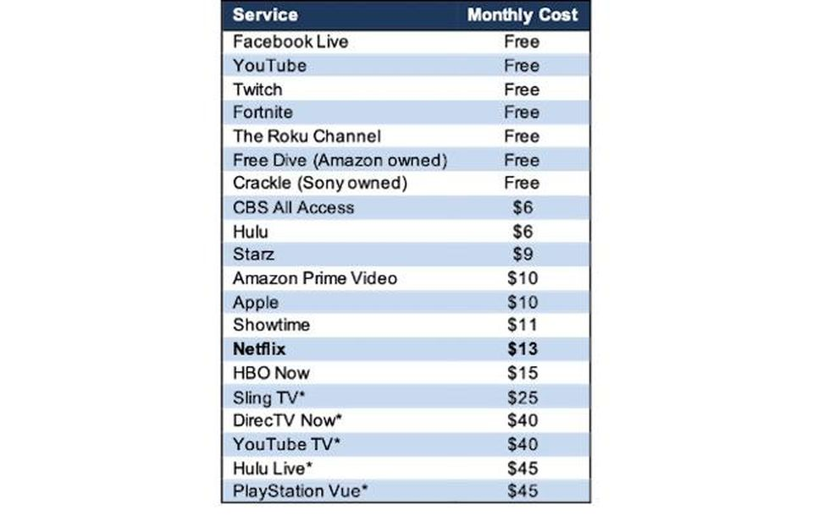
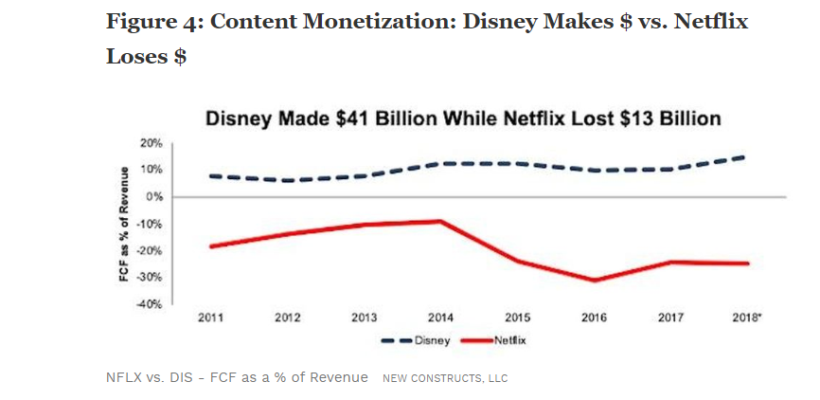
MMA 801 – Session 1
https://www.forbes.com/sites/greatspeculations/2019/02/05/reality-is-closing-in-on-netflix/#3621fe45ed0b

Slide 42
MMA 801 – Session 1
Financial Road Map to Success
ROS emphasis
Revenue model structure & drivers
Revenue
Margins
Minus
Cost base structure & drivers
Costs
Net
Income
Times
Return On
Invested Capital
Market
Share
Share of market
Divided By
Volume
Assets
Deployed
Times
ROIC or ROCE
Market
Size
Total available market, & total accessible market
PIMS emphasis
Invested Capital, Working Capital, tangible asset base
Netflix – borrowing $13B to fund programming, as costs exceed fees from subscribers
Disney – HULU unprofitable until 2023 at the earliest…Disney+ 2024?
HBO Max – unprofitable until 2024 at the earliest
Apple TV, Amazon Prime Video, CBS All Access, YouTube TV all not covering their costs

Slide 43
MMA 801 – Session 1
Framing Critical Conclusions – Dynamic Intuitiveness Analysis
Modest Disruptive Change Agents
Modest
Is Demand being Unbundled or Redefined?
(Customization, simplification, unbundling)
Are markets being recreated
(Via Cheaper or Easier Ways to Connect supply and demand)
Are supply and/or capacity fundamentals being redefined
DEMAND
SUPPLY
Has the Value Curve been redefined
(Enrich product or service)
What degree of Hyperchange is occurring to Operational Platforms
(New Value Chains and Ecosystems)
Are Business Systems being totally restructured?
(Change Supply Side Structure -
automate, virtualize, disintermediate)
Significant Disruptive Change Agents
Adapted from: The Economic Essentials of Digital Strategy, Dawson, Hirt, Scanlan, McKinsey Quarterly

Slide 44
MMA 801 – Session 1
Value Conclusions
Customer Perceived Value
Source-specific Value Components (Direct Value)
Tangible & intangible features & services
Imbedded Network (Ecosystems) Dependency Values (Indirect Value)
Complementary products & partners (channel relationships)
Cumulative Number of Users
Compatible Relationships (Technology, etc.)
Recognizing both specific and embedded network/ecosystem dependencies

Slide 45
MMA 801 – Session 1
Dynamic Intuitiveness – Summarization
Understanding the relationship between the internal ecosystem, external networks and ecosystem, and strategic opportunity.
Ability to continuously stay at the forefront of the market sectors within which we compete.
Predicated on understanding:
Value fundamentals and trends
Positioning outcomes (variety, needs-based, granulated) which reinforce value to the existing customer base, woo customers from rivals, and connect with new customers
Required actions embodying continuous improvement via transformational versus incremental planning
Predicated on executing:
Operational fit and effectiveness across a range of focused, value-driven activities
Creating an ecosystem which blocks the fundamentals of competitive convergence
EKNResearch.com

Slide 46
MMA 801 – Session 1
Dynamic Intuitiveness Conclusions – Decision-making Focus…what would it be? Critical questions to ponder.
Do we have a clear view of the competitive landscape?
Do we have the right assets and capabilities to compete?
Do we adjust, reframe, reinvent our product/service strategy?
Where and how are digital technologies and/or other factors reshaping the way that we do business?
What, where, how, and when are the new risks which we must respond to and overcome?

Slide 47
MMA 801 – Session 1
Strategy Decision-Making Circle
Recognize the forces & factors impacting your Ecosystem…Porter, PESTEL, Market Structure, SWOT, etc.
Frame
(Ecosystem Dynamics)
Baseline
(Pivot Requirement)
Search
(Option/Response
Identification)
Choose
(Craft Strategic Response & Plan)
Commit
(Resource procurement, allocation, sequencing)
Assess & Adjust
Track (KPMs), evaluate, adjust
Draw conclusions relating to competitive strength & degree of change required
Creative Insight
Strategic Vision
Strategic Execution
Strategic Thinking
Execute the strategy & tactics (organic and inorganic)
Create & destroy response and opportunity options – multiple horizons
Strategic Planning
Business Model & Ecosystem Framing
Create/redefine the "Value" delivery blueprint – maintain, enhance, reduce, remove.
Magnitude & speed conclusions

Slide 48
MMA 801 – Session 1
Strategic Planning - Summarization
Where & Why
What
How
Execute & Evaluate
Options
Strategic Vision
Goals and Aspirations
Four Keys
We need to know where we are
We need to know how we got there
We need to know where we are trending
We need to know when to make timely change
Inflection or Pivot Point
Critical success markers along the way which will define future inflection points
Recognition of where we are at versus where we want to be
Time
Notes:
Walmart AGM – focus was on reimagining the company and the retail sector overall.
Technology disruption – Omni-Channel Experience
Trending – e-Commerce Retail Survey

Slide 49
MMA 801 – Session 1
Four Key Strategy Process Hurdles
Inertia Hurdle
(power of vested interest…wedded to the status quo)
Resource Hurdle
(limited resources, lack of experience or expertise)
Execution Hurdle
(follow through in a sustained and meaningful way… leverage competitive advantage and privileged insight)
Contamination Hurdle
(inherent bias, ill-conceived notions or perceptions, false conclusions)
Analytics is critical here

Slide 50
MMA 801 – Session 1
Strategy Decision-Making – Your Conclusion(s)?
Dynamic Environment
Leadership
Management
Strategy
Board of Directors
Competitive Advantage or Erosion
Profitable Growth or Erosion
Organization
Influential Stakeholders
Competitors
Company direction is driven by leadership's view of the market and its related attractiveness and profit potential. This then cascades into a series of objectives and decisions which impact its performance relative to advantage and profitability.

Slide 51
MMA 801 – Session 1
Strategy Misalignment – Cascading Impact
Misunderstanding Environmental Dynamics
Leadership
Leads to
Ineffective Management
Overly-Aggressive Strategies
Passive/Dominant
Board of Directors
Competitive Erosion
Profitability Erosion
Leads to
Organization Misalignment
Overly-Influential Stakeholders
Leads to
Competitor Advantage
Your Risk – Offsetting inherent decision-making, structural, and executional biases which erode advantage and profitability, thereby magnifying obstacles (hurdles) of performance

